Slide 1
Multiple relationships between two tables
Management Information Systems
Disha Parkhi

Slide 2
Outline
Multiple relationships between the same pair of tables:
  The Commuter Airline
Reading:
Chapter 8: 171-184
We are doing only one example in class, the other examples in the chapter are good practice exercises.

Slide 3
The Commuter Airline
DB Design Exercise

Slide 4
Multiple rel. between two tables
The Commuter Airline
Your firm operates a commuter airline covering portions of western Canada and the northwest United States. Presently, you store your schedule in a database with the following tables:
FLIGHT (FlightNumber, OriginAirport, DepartureTime, DestinationAirport, ArrivalTime, PlaneCode)
PlaneCode foreign key to KINDOFPLANE
FLIESONDAY (FlightNumber, Day)
FlightNumber foreign key to FLIGHT
KINDOFPLANE (PlaneCode, FullPlaneName, SeatingCapacity)
OriginAirport and DestinationAirport are standard three-letter airport codes (like “EWR” for Newark). The permitted values of Day in the FLIESONDAY table are “Weekdays”, “Saturday”, or “Sunday”.

Slide 5
For instance, the records shown below indicate that flight 123 operates between Calgary, Alberta (airport code YYC) and Helena, Montana (airport code HLN), departing 10:00 AM and arriving 12:30 PM on weekdays and Saturdays, but not operating on Sundays; the flight uses a De Havilland Dash 7 turboprop aircraft (PlaneCode DH7), which seats 50 people. The records pertaining to other flights and kinds of aircraft are not shown.
FLIGHT: 123 YYC 10:00 HLN 12:30 DH7
KINDOFPLANE: DH7 “De Havilland Dash 7 Turboprop” 50
FLIESONDAY:
  123 Weekdays
  123 Saturday
(a) Draw an entity-relationship diagram for this database.

Slide 6
Suppose the operations department decides that Saturday demand for flight 123 is too small to justify a DH7 aircraft, and they want to substitute a smaller Saab 340 aircraft on Saturdays. They will continue to use the DH7 aircraft on weekdays.
(b) With this change of aircraft, briefly explain why the database forces you to assign a different flight number to the Saturday flight, even though its scheduled arrival and departure information are identical to the weekday flight.
(c) Redesign the database so the same flight number can be used on every day a flight operates, even if different aircraft are used.
Write a new entity-relationship diagram and database design outline.

Slide 7
(d) Suppose you want to be able to print reports in which you list not only the three-letter codes for airports, but their full names. For example, a line of the report might read
Flight 123 Departs Calgary, Alberta 10:00am Arrives Helena, Montana 12:30pm
You plan to add the following table to the database:
AIRPORT (Code, name, state/province, altitude, latitude, longitude)
Draw a new entity-relationship diagram and design outline for database.

Slide 8
Creating such relationships in Access

Slide 9
Multiple relationships between the same two tables in Access
After creating the first relationship between FLIGHT and AIRPORT, establishing the second relationship between FLIGHT and AIRPORT is a little tricky in Access. If we drag the second foreign key over the primary key of AIRPORT, we get a warning that a relationship already exists. The dialog box asks if we want to edit the existing relationship, or create a new one. If we click “no” to create a new relationship, and then click “enforce referential integrity” and “OK”, we get the desired result.
The second “table” AIRPORT_1 in this depiction is not really a second table; this is just how MS Access represents a second relationship.
Thus, the way the relationships window shows multiple relationships between the same two tables is not exactly the same as we would draw in the ER diagram.

Slide 10
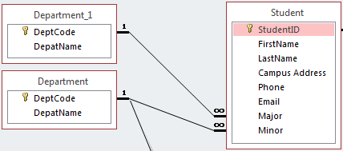
Another example…
After creating the first relationship between STUDENT and DEPARTMENT, establishing the second relationship cannot be done the same way. If we drag the primary key of DEPARTMENT to the second foreign key in STUDENT, we get a warning that a relationship already exists. The dialog box asks if we want to edit the existing relationship, or create a new one. If we click “no” to create a new relationship, and then click “enforce referential integrity” and “OK”, we get the desired result.
The second “table” DEPARTMENT_1 in this depiction is not really a second table nor a copy of the DEPARTMENT table; this is just how MS Access shows a second relationship between the same two tables.
The way the relationships window shows multiple relationships between the same two tables is not exactly the same as we would draw in the ER diagram.

Slide 11
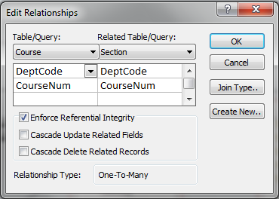
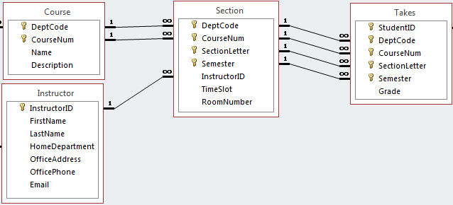
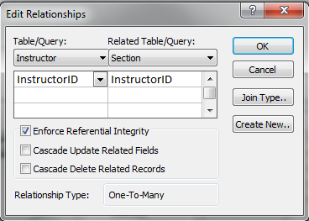
Note! A relationship with composite keys in Access
These both correspond to a single relationship!
A relationship where the PK/FK is composite has both fields of the PK and FK here
A relationship where the PK/FK is not composite has a single field corresponding to the PK and FK here

